Slide 1



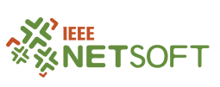
Towards Network-Aware Resource Provisioning in Kubernetes for Fog Computing applications
José Santos, Tim Wauters, Bruno Volckaert, Filip de Turck
IEEE Conference on Network Softwarization (NETSOFT 2019)
24 – 28 June, 2019 – Paris, France
Notes:
In the next minutes, you will learn how a well-known platform (called) Kubernetes, a container management platform, can be used to properly allocate services for IoT or Smart City environments. Specifically, how we can fine-tune the already available scheduling features in Kubernetes to tailor the provisioning particularly for this kind of services.
“Over the last few years, the Internet of Things (IoT) and Smart Cities continued to expand at enormous rates. However, Smart City applications are still far from being a reality. Current Telecommunication networks are facing tremendous challenges to support these new applications. As an answer, Fog Computing has been introduced to deal with the massive growth of connected devices. We decided to evaluate a well-known platform, Kubernetes, an open source management platform for containers and see if it can be used for IoT services. Then, we realized that Kubernetes Scheduling features could be improved by enabling provisioning decisions based on the network infrastructure. You will learn about this in the next minutes.”

Slide 2
50 billion!
Notes:
Did you know that according to Cisco, the number of connected devices will exceed 50 billion by 2020!!
We often hear high numbers…

Slide 3



But how “big” 50 billion really is?
1 million seconds
1 billion seconds
50 billion seconds
12 days
30 years
16 centuries
Notes:
So let me make an analogy with time…
1 million seconds is 12 days (Interesting)
1 billion seconds corresponds to 30 years (Quite impressive, right?)
Now, 50 billion seconds (50 times more than the previous) is equivalent to 16 centuries (Massive)

Slide 4
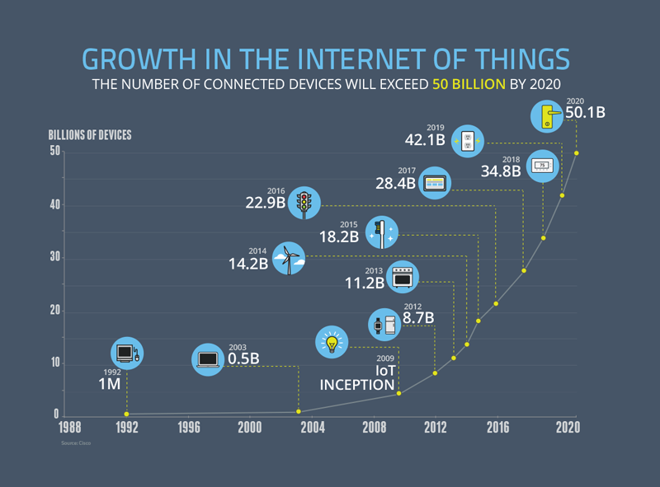
Notes:
The market for IoT is growing fast the last couple of years.
Several companies are trying to deploy their products & services in the growing IoT ecosystem, but challenges still remain to be answered…

Slide 5
Outline
How can we deal with the massive growth of IoT?
How can we improve Kubernetes Scheduling Features?
How can we evaluate our approach?

Slide 6

“If you think that the internet has changed your life, think again. The Internet of Things is about to change it all over again!” Brendan O’Brien, Aria Systems co-founder
Notes:
IoT is not only about the devices, is also about the connectivity. How can we effectively connect all this heterogeneous devices in an optimized way/manner?
These devices are currently revolutionizing different domains of urban life, such as Waste management, trucks are informed by sensors when the waste bins are full. So, their route is optimized by not wasting time driving to empty bins. Street lighting, Proximity sensors reduce the energy consumption of City lampposts by making sure they only turn on when cars or citizens get near and turn off when no one is around and environmental monitoring, imagine for example a mobile application able to send you alert messages in case air pollution is detected on a given street.
To meet the high demanding requirements of these applications, Fog Computing has emerged as a distributed cloud solution. It provides nearby resources to end devices to perform real-time processing, data analytics operations and storage procedures overcoming the limitations of traditional centralized cloud infrastructures.
Nevertheless, Fog Computing is still in its early stages thus research challenges in terms of resource provisioning and service scheduling persist. In fact, setting up a proper infrastructure to serve billions of IoT devices and their applications, in real-time, without dismissing the importance of energy efficiency, bandwidth usage and geographic distribution is still a challenge to be addressed.
Container-based services are revolutionizing the way developers build their applications. An application is decomposed in a set of lightweight containers deployed across a large number of servers instead of the traditional single monolithic application. Each micro-service is developed and deployed separately, without compromising the application life-cycle. Currently, containers are the de facto alternative to the traditional Virtual Machines (VMs), due to their high portability and low resource usage. Furthermore, with their wide adoption, multiple orchestration solutions are being developed by IT companies and open-source communities. Among them, the most widely used today is called Kubernetes.
Aria Systems’ co-founder Brendan O’Brien has long been an advocate for and pioneer of IoT’s and monetization’s place in the the enterprise and is thrilled that people are finally thinking about monetizing IoT initiatives.

Slide 7

What exactly is Kubernetes?
Container Orchestration Platform
Robust & Reliable
Scaling up Containers (Docker)
Massive Open Source Community
Notes:
But What exactly is Kubernetes?
Kubernetes is an open-source orchestration platform for containerized applications.
Kubernetes simplifies the deployment of reliable, scalable distributed systems by managing their complete life-cycle work-flow.
Kubernetes enables the automatic scaling of containers through Docker
Kubernetes has a massive open source community which is constantly working towards its improvement
Due to all of this, Kubernetes is positioning itself as the de facto platform for the orchestration of container based services.

Slide 8
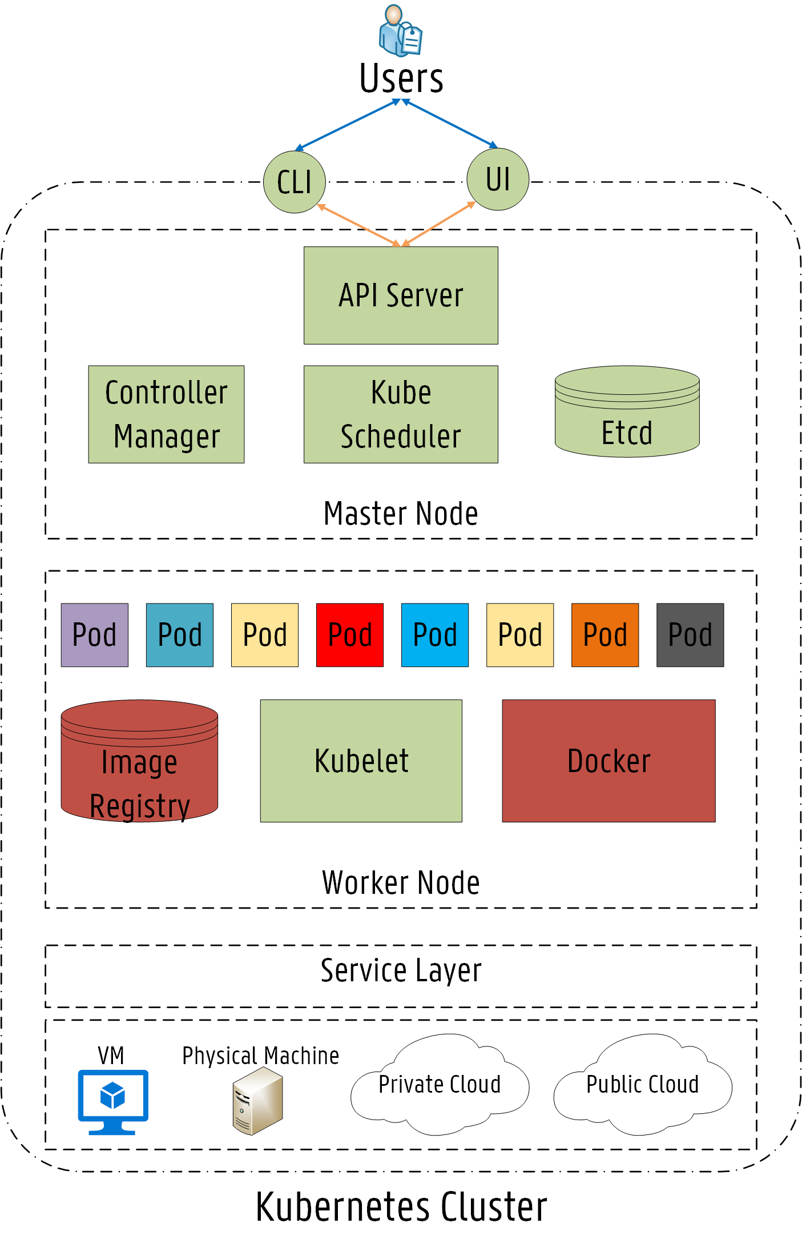
Kubernetes Architecture
Notes:
Now, you will learn about the main features/characteristics of the Kubernetes architecture.
The architecture follows the master slave model, where at least one master node manages Docker containers across multiple worker nodes (slaves). These worker nodes can be local physical servers and VMs or even public and private clouds. The Master is responsible for exposing the API server, scheduling the service deployments and managing the overall cluster. The API server provides an entry point to control the entire Kubernetes cluster.
Micro-services in Kubernetes are often tightly coupled forming a group of containers. This group is the smallest working unit in Kubernetes, which is called a pod.
A pod represents the collection of containers and volumes (storage) running in the same execution environment. The containers inside a pod share the same IP Address and port space (namespace). Containers in different pods are isolated from one another since they own different IP addresses, different hostnames, etc. The main limitation is that two services listening on the same port cannot be deployed inside the same pod.
Based on the service requirements and on the available resources, the master schedules the pod on a specific node. Then, the assigned node pulls the container images from the image registry if needed and coordinates the necessary operations to launch the pod. The scheduling operation of assigning a node of the cluster to each pod is performed by the Kube-scheduler (KS) component. The KS is the default scheduling component in the Kubernetes platform, which is responsible for deciding where a specific pod should be deployed.

Slide 9
Outline
How can we deal with the massive growth of IoT?
How can we improve Kubernetes Scheduling Features?
How can we evaluate our approach?
Notes:
But how this KS works exactly?
Is there any way of fine tuning the scheduling behavior specifically for IoT or Smart City environments?
These questions are answered next…

Slide 10
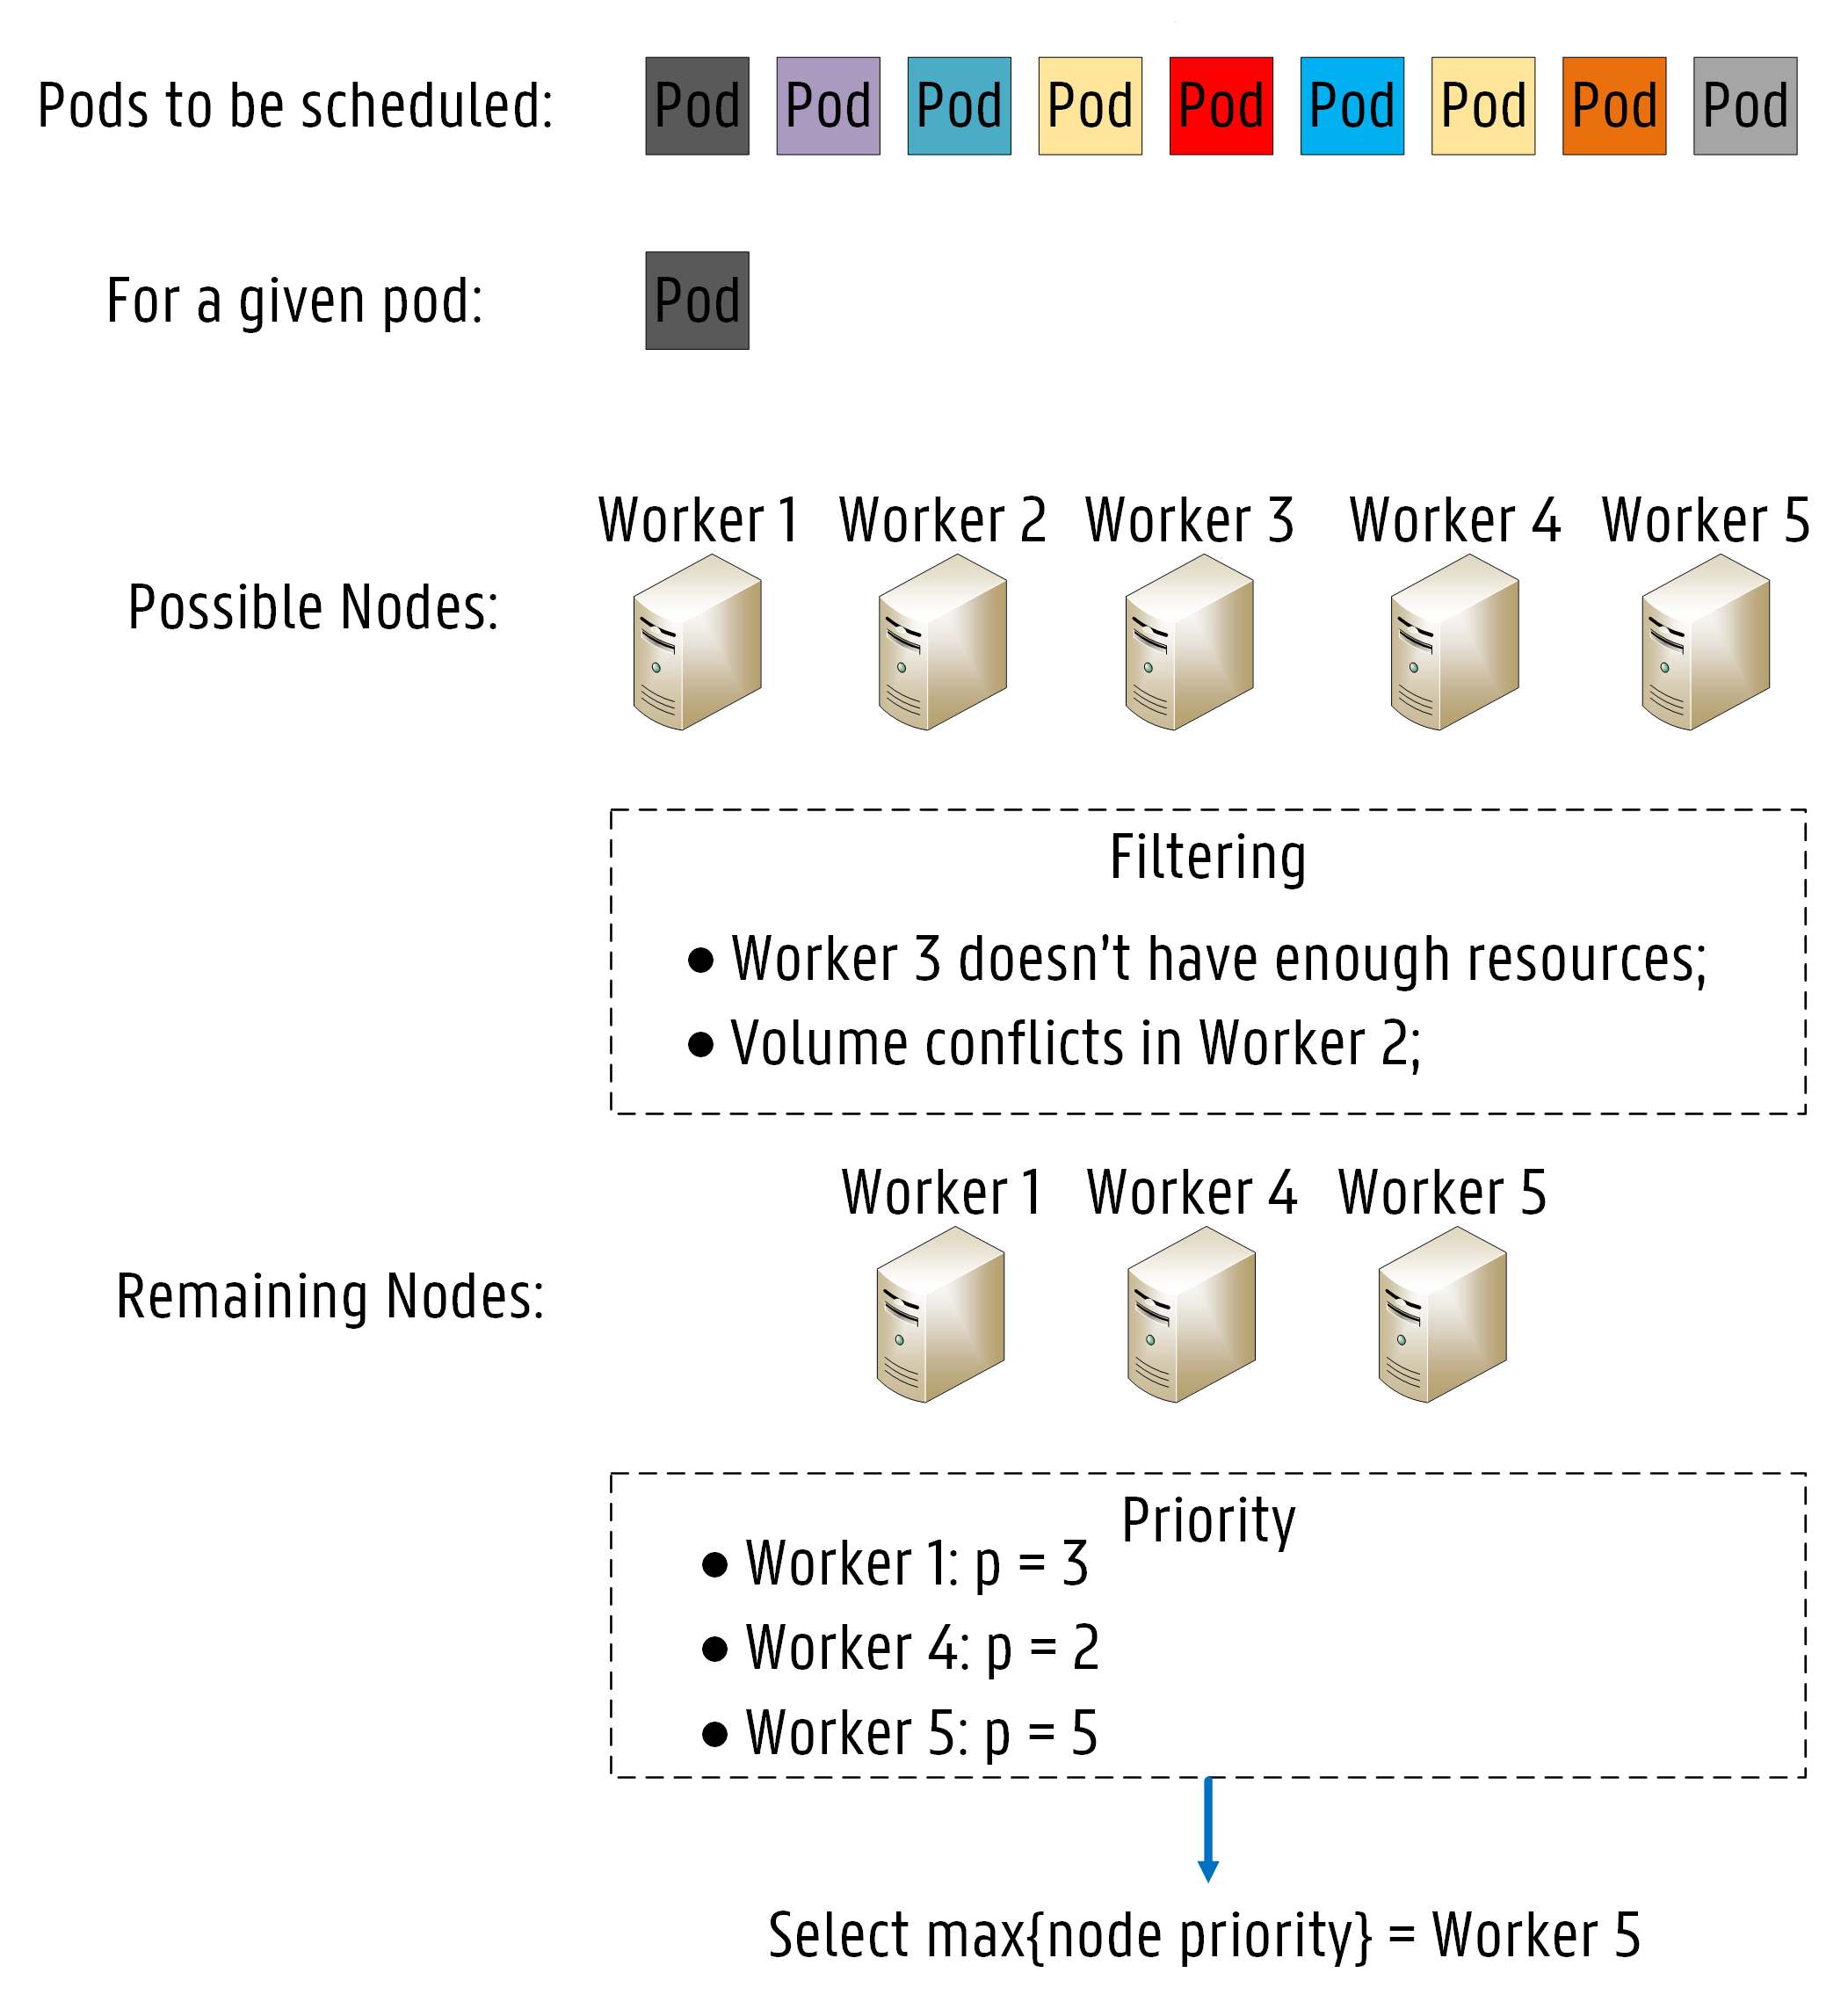
Kube-Scheduler (KS)
How does it work?
1
Node Filtering
2
Node Priority Calculation
Notes:
Every pod needing allocation is added to a waiting queue, which is continuously monitored by the KS. If a pod is added to the waiting queue, the KS searches for a suitable node for the
deployment based on a two step process. The first step is called node filtering, where the KS verifies which nodes are capable of running the pod by applying a set of filters, also known
as predicates.
The purpose of filtering is to solely consider nodes meeting all specific requirements of the pod further in the scheduling process.
The second operation is called node priority calculation, where the KS ranks each remaining node to find the best fit for the pod provisioning based on one or more scheduling algorithms, also called priorities.
Each algorithm is weighted and each node is scored between 0 and 10. The highest scoring node is chosen to run the pod.

Slide 11

Kube-Scheduler (KS)
Fast Decision Time
Easily extensible
Lack of specific rules
Only CPU and RAM
Notes:
One of the main strongest points of KS is the fast decision time in the order of ms (as I will shown further in my presentation).
KS is also easily extensible in case someone would like to make scheduling decisions on a specific rule/algorithm not yet present in the KS.
BUT Although KS provides flexible and powerful features, the metrics applied in the decision making process are rather limited. Only CPU and RAM usage rates are considered in the service scheduling.
When IoT or Smart City environments are considered, latency and bandwidth are highly challenging constraints.
For example, bandwidth limitations may cause network congestion and even service disruptions, which could eventually lead to service interruptions while latency thresholds if exceeded can lead to unstable services.
Therefore, for these kind of services, it is crucial to provide a provisioning approach considering multiple factors, such as the applications’ specific requirements (CPU and memory), the state of the infrastructure (hardware and software), the network status (link bandwidth and latency), among others.
Kubernetes QoS
“API-responsiveness: 99% of all our API calls return in less than 1 second”
“Pod startup time: 99% of pods (with pre-pulled images) start within 5 seconds. “

Slide 12
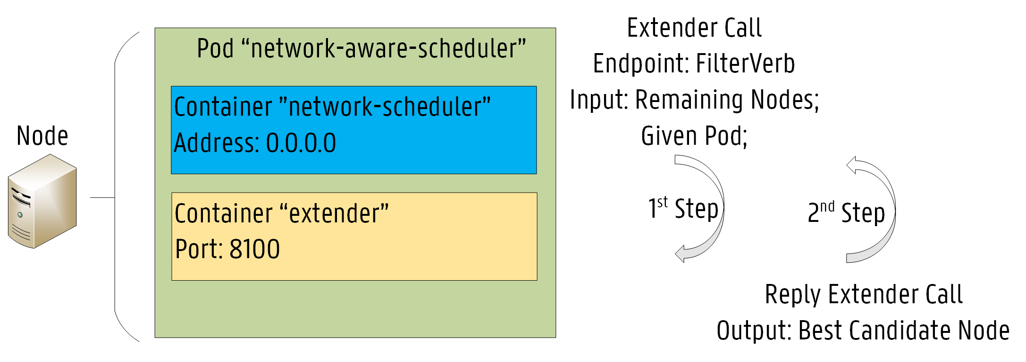
Network-Aware Scheduler (NAS)
Implemented by extending KS:
1
Node Filtering
2
Minimization of RTT
Bandwidth Conservation
Notes:
In this paper, we proposed a network-aware scheduling extension to Kubernetes, which provides service provisioning decisions based on up-to-date information about the current status of the network infrastructure.
Our Network-Aware Scheduler (NAS) is implemented by creating an “extender” process that the default KS calls out as a final step when making scheduling decisions. This extension approach is particularly suitable for use cases where scheduling decisions need to be made on resources not directly managed by the standard KS, which is exactly our case, since information on the current status of the network infrastructure is not available throughout the default scheduling process (KS).
We extended KS through the filter endpoint. The arguments passed on to the Filter endpoint consist of the set of nodes already filtered by KS and the given pod.
The NAS makes use of strategically placed RTT labels to decide where it is suitable to deploy a specific service based on the target location specified on the pod configuration file.
Round Trip Time (RTT) values are assigned to each node as a label so that delay constraints can be considered in the scheduling process. Furthermore, the available bandwidth on each node is also assigned as a label.
The node selection is based on the minimization of the RTT depending on the target location for the service after the completion of the filtering step.
Additionally, in terms of bandwidth, NAS checks if the best candidate node has enough bandwidth to support the given service based on the bandwidth requirement specified in the pod conf. file and on the available bandwidth label. After completion of the scheduling request, the available bandwidth is updated on the correspondent node label.

Slide 13
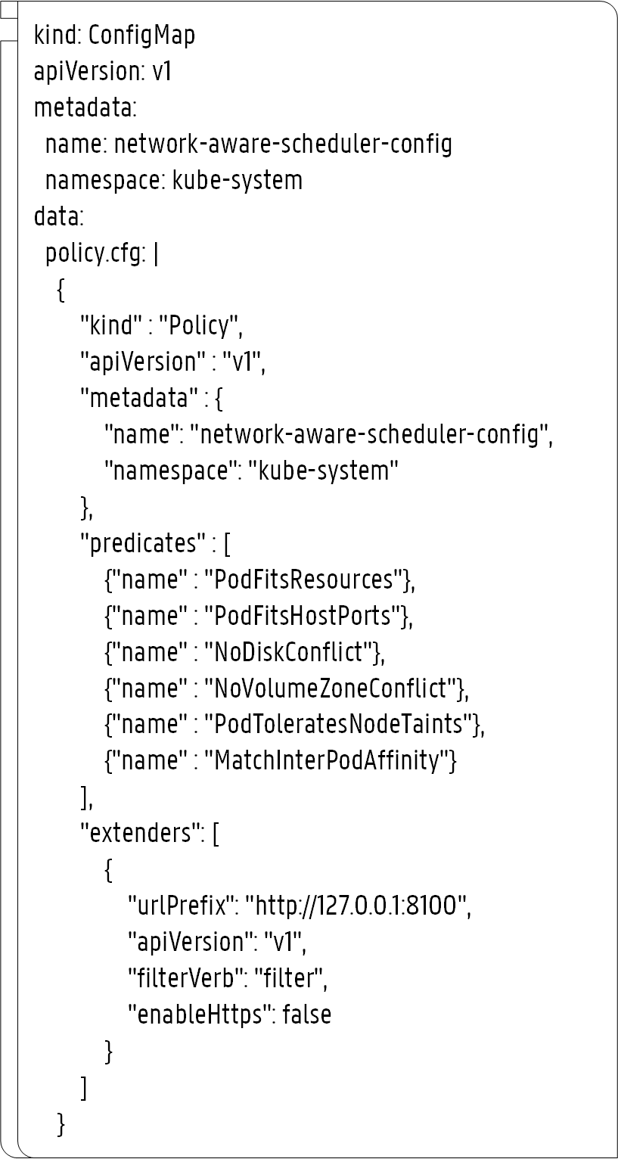
YAML Files
Scheduler Policy Configuration
Policy Name
1
Predicates
2
Extender
3
Notes:
The policies of our scheduler are specified in a conf. file.
We defined the predicates used by the KS to filter the nodes.
We define where the KS needs to call out our extender process.

Slide 14
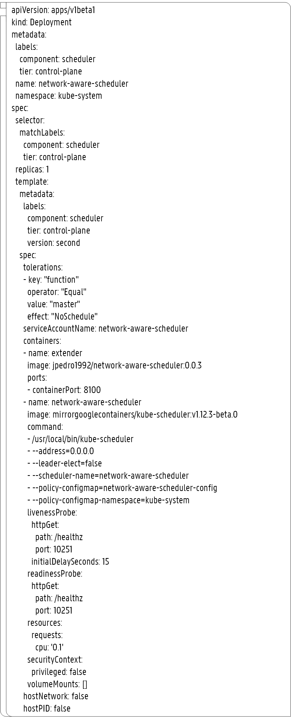
YAML Files
Account Configuration
1
Scheduler Deployment
Extender Container
2
KS Container
3
Notes:
The deployment of our scheduler is also specified in a conf. file.
As can be seen, the pod is composed by two containers: the extender and the NAS.
The extender is responsible for performing the proposed scheduling decision while the NAS is in fact the actual KS

Slide 15
Outline
How can we deal with the massive growth of IoT?
How can we improve Kubernetes Scheduling Features?
How can we evaluate our approach?
Notes:
Now, I will talk about the evaluation approach that we followed and the results that we obtained.

Slide 16
Evaluation Approach
Notes:
First, about the evaluation approach…

Slide 17
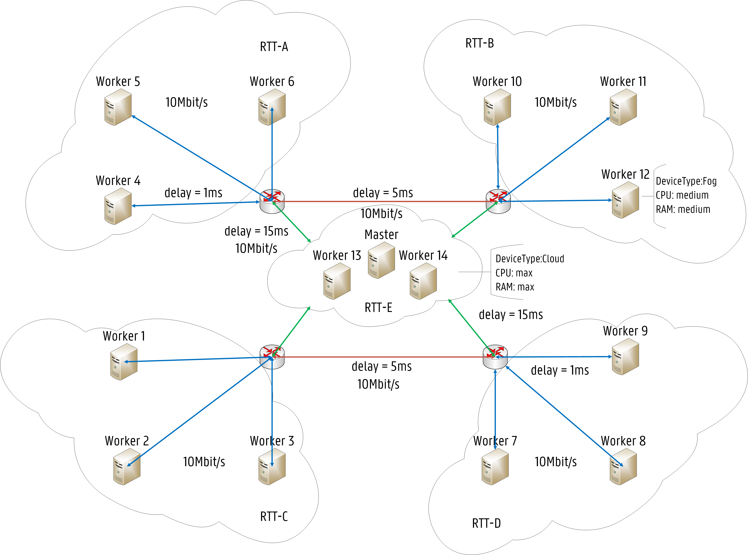
Evaluation Scenario
RTT Labels (e.g. Worker 1)
1
RTT-A: 64.0 ms
2
RTT-B: 64.0 ms
3
RTT-C: 2.0 ms
4
RTT-D: 14.0 ms
5
RTT-E: 32.0 ms
6
Av. Bandwidth: 10Mbit/s
Notes:
Our testbed infrastructure was composed by a Kubernetes cluster with 15 Nodes (1 Master, 14 Worker Nodes)
Nodes were assigned several labels. For instance, RTT labels depending on the locations. For example, for worker 1…
A label is also used for the av. Band. On the node to keep track of the allocated band. …

Slide 18
Services
Deployment Properties (e.g. Birch-api)
Replication Factor: 4
Target Location: RTT-A
Min. Bandwidth: 2.5 Mbit/s
100/500m CPU
128/256Mi RAM
Pod Anti-Affinity rule
Birch
Birch-api
Birch-cassandra
1
2
Robust
Robust-api
Kmeans
Kmeans-api
Kmeans-cassandra
3
4
Isolation
Isolation-api
Notes:
4 services were used to evaluate our scheduler. In terms of deployment properties:
The number of service instances is defined by the replication factor;
The service desired location is expressed by the target location;
The min. band. defines the min. band. needed for the proper service operation.
Then, resource requests and limits are defined in terms of CPU & RAM;
A pod anti-affinity rule was also added to each service so that pods belonging to the same service are not deployed together, meaning that a node can only allocate one instance of a certain pod.

Slide 19
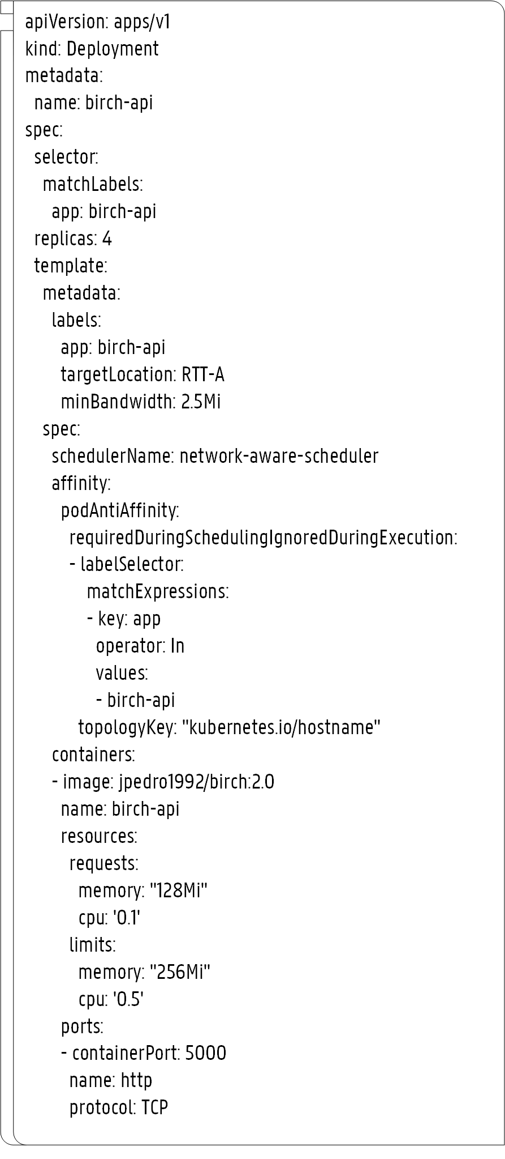
YAML Files
Birch-api Service Configuration
1
Replication Factor: 4
Target Location: A
Min. Bandwidth: 2.5 Mbit/s
2
3
Scheduler
Affinity Rules
4
Resource Requests
5
Notes:
All these service requirements need to be specified in the pod conf. file:
Replication Factor;
Target Location;
Min Band;
Scheduler Name;
Affinity Rule;
Last, resource requests…

Slide 20
Results

Slide 21
Execution Time
Extender Decision
Scheduling Decision
Pod Startup Time
KS
0 ms
2.14 ms
2.02 s
NAS
4.82 ms
6.44 ms
2.10 s
Notes:
On average KS decides in 2ms. The extender call is not issued thus the 0ms.
Our scheduler takes longer since the extender call is issued to decide in terms of latency and Band. The NAS requires on average between 6-7 ms.
Essentially, our approach takes 5ms more than the KS.
The pod startup time is the time between the submission of the pod configuration file to the Kubernetes API and until the pod is deployed on a given node and ready to be used. Both KS and NAS require on average 2 seconds.
Now, let’s see if by increasing the scheduling decision in 5ms we could gain in other aspects…

Slide 22
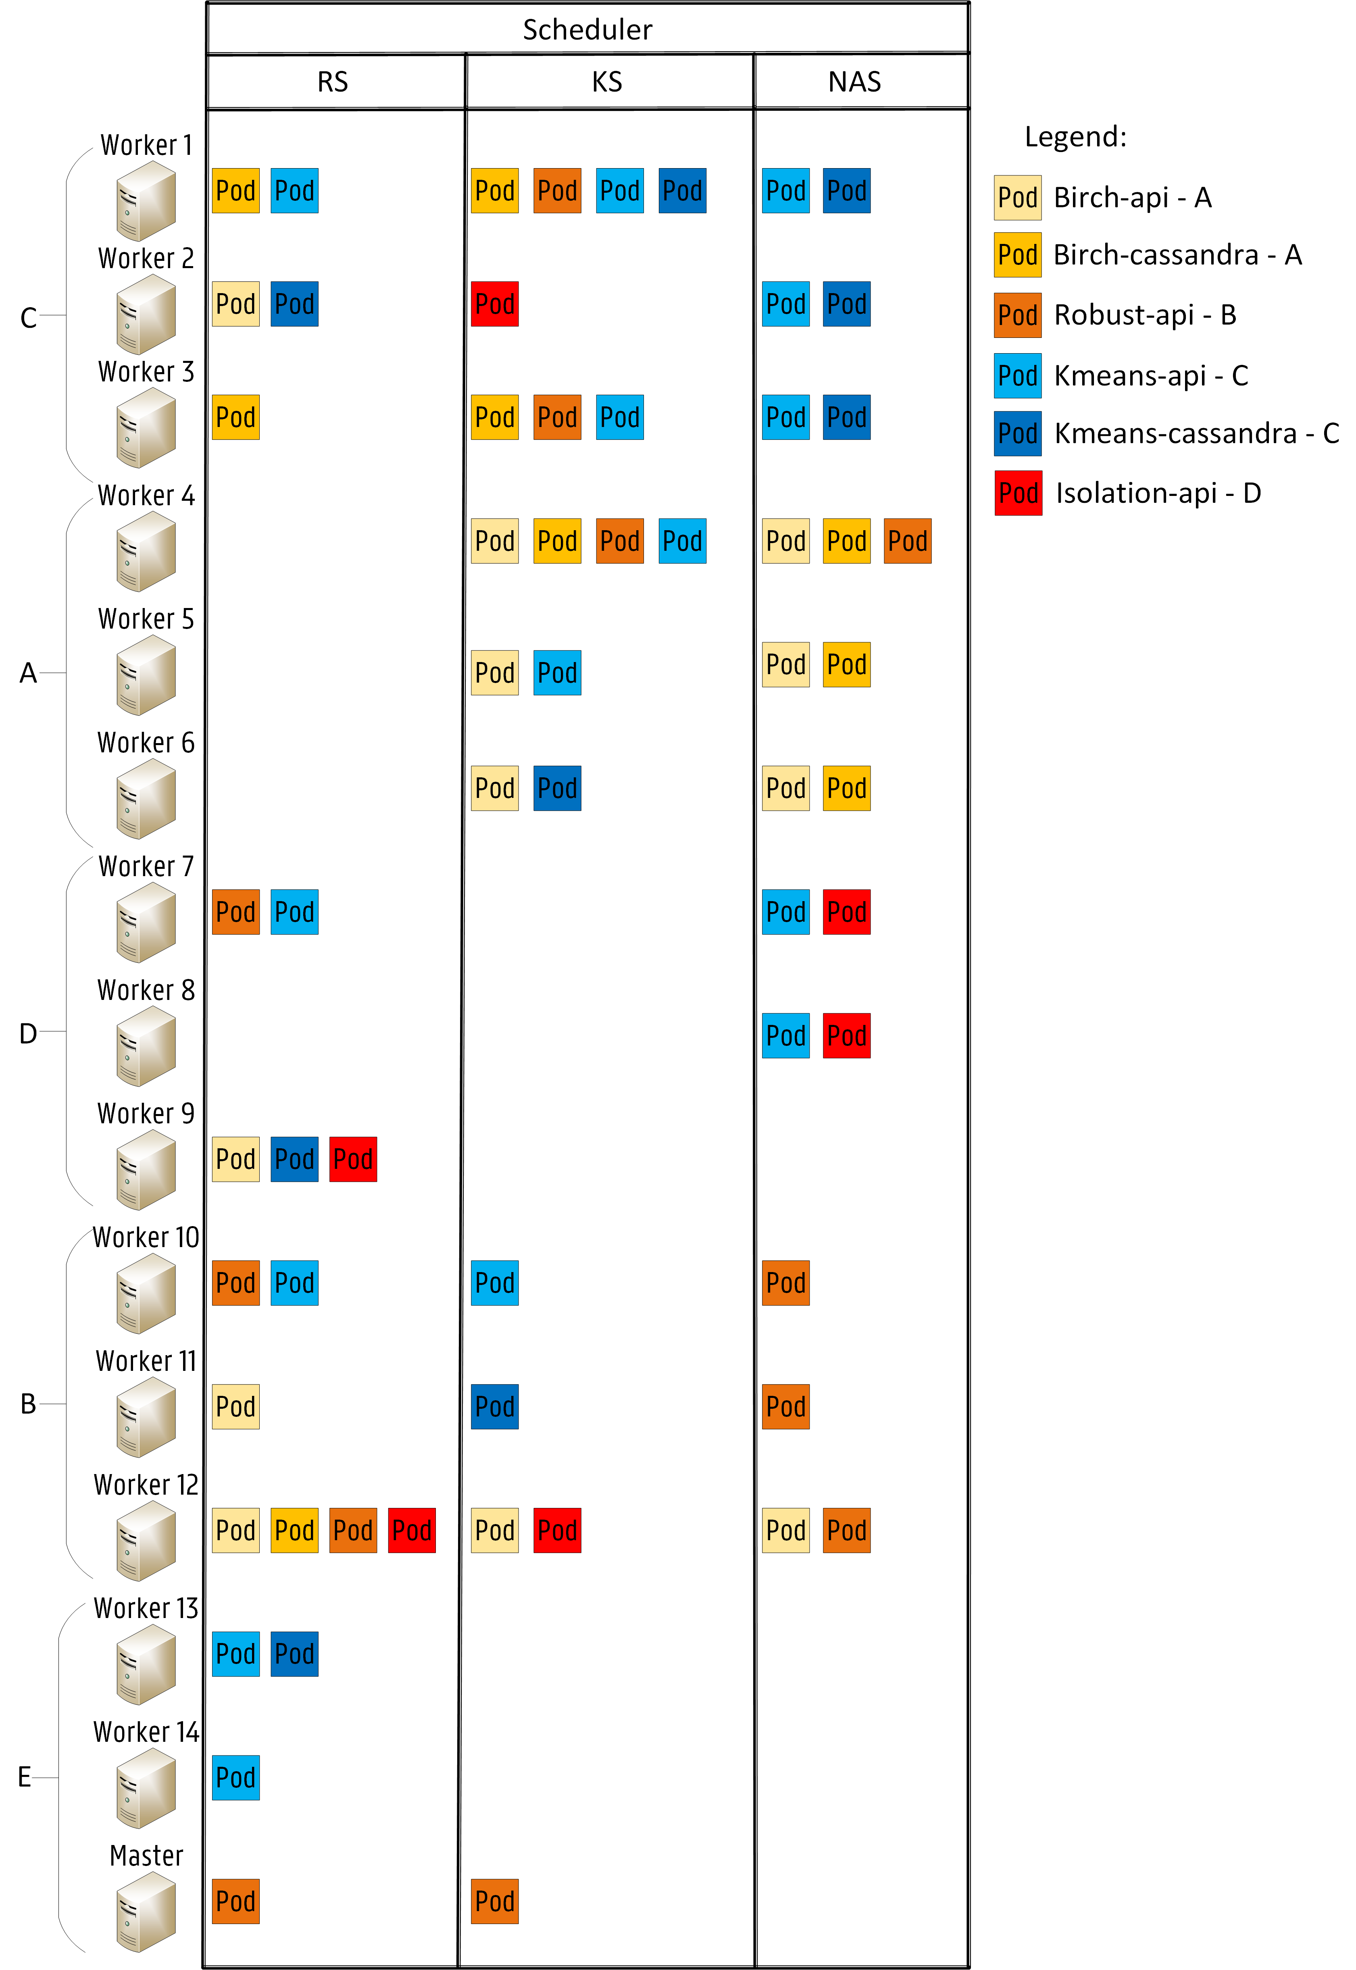
Allocation Scheme
Notes:
In terms of the allocation scheme, another schedule was evaluated: a random scheduler, which first filters the inappropriate nodes and then selects a random node for the deployment.
As it can be seen, both the random and KS are not optimized for the service desired location since no considerations are made about network latency.
KS only makes decisions based on CPU & RAM.
Our scheduler is capable of deploying all services on the desired location if possible (pod anti affinity rule -> 3 nodes per location/ Band. conservation).
For example. In terms of band, KS overloads worker 1 and 4 by allocating on them 4 pods which surpasses the available bandwidth of 10 Mbit/s. This allocation scheme
may lead to service disruptions due to bandwidth fluctuations.

Slide 23
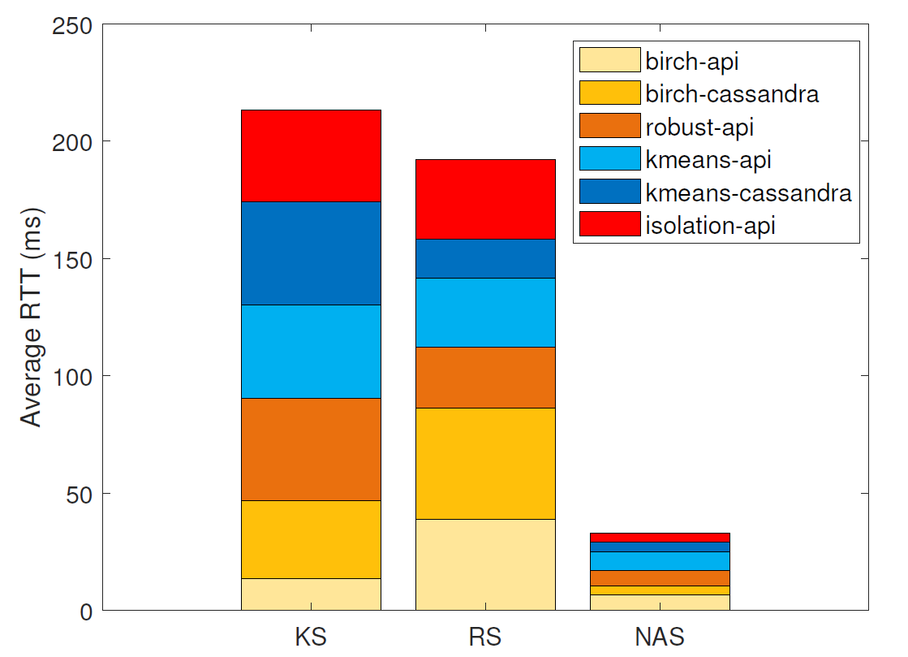
Average RTT
80%
Notes:
In terms of RTT, as shown, the proposed NAS achieves significantly lower RTTs for each of the deployed services.
For instance, the RTT is on average 4 ms when the NAS provisions the isolation-api service while for the RS and the KS, the RTT is on average 34 ms and 39 ms, respectively.
By just increasing the KS execution time by 6 ms by issuing an extender call, the service provisioning in terms of network latency is highly improved.
In fact, the NAS for this service scheme can improve the performance of the default KS by reducing the network latency by 80%.

Slide 24
Conclusions
Allocation decisions based on the network infrastructure
Validated in Kubernetes.
Results:
80% reduction of network latency
Future Work:
Deployment in a real Smart City
Notes:
Allocation decision for IoT services based on latency & band. Were validated in Kubernetes;
We obtained a reduction of 80% (service latency) when compared with the default KS.
As future work, our approach will be deployed in a real Smart City as the CoT testbed in Antwerp, Belgium.

Slide 25

Thank you for your attention!
Questions?
José Santos
Ghent University – imec, IDLab
josepedro.pereiradossantos@UGent.be

Slide 26
Random Scheduler (RS)
Also implemented by extending KS
1
Node Filtering
2
Random pick
Notes:
The random selection of the node is, in fact, a random pick after the KS filters out the inappropriate nodes:

Slide 27
RTT labels
Node | RTT-A | RTT-B | RTT-C | RTT-D | RTT-E
Mater | 32 ms | 32 ms | 32 ms | 32 ms | 4 ms
Worker 1 | 64 ms | 64 ms | 4 ms | 14 ms | 32 ms
Worker 2 | 64 ms | 64 ms | 4 ms | 14 ms | 32 ms
Worker 3 | 64 ms | 64 ms | 4 ms | 14 ms | 32 ms
Worker 4 | 4 ms | 14 ms | 64 ms | 64 ms | 32 ms
Worker 5 | 4 ms | 14 ms | 64 ms | 64 ms | 32 ms
Worker 6 | 4 ms | 14 ms | 64 ms | 64 ms | 32 ms
Worker 7 | 64 ms | 64 ms | 14 ms | 4 ms | 32 ms
Worker 8 | 64 ms | 64 ms | 14 ms | 4 ms | 32 ms
Worker 9 | 64 ms | 64 ms | 14 ms | 4 ms | 32 ms
Worker 10 | 14 ms | 4 ms | 64 ms | 64 ms | 32 ms
Worker 11 | 14 ms | 4 ms | 64 ms | 64 ms | 32 ms
Worker 12 | 14 ms | 4 ms | 64 ms | 64 ms | 32 ms
Worker 13 | 32 ms | 32 ms | 32 ms | 32 ms | 4 ms
Worker 14 | 32 ms | 32 ms | 32 ms | 32 ms | 4 ms

Slide 28
Deployment Properties
Service Name | Pod Name | CPU Req/Limit (Mi) | RAM Req/Limit (Mi) | Min. Bandwidth (Mbit/s) | Repl. Factor | Target Location | Dependencies
Birch | birch-api | 100/500 | 128/256 | 2.5 | 4 | A | birch-cassandra
 | birch-cassandra | 500/1000 | 1024/2048 | 5 | 3 |  | birch-api
Robust | robust-api | 200/500 | 256/512 | 2 | 4 | B | none
Kmeans | kmeans-api | 100/500 | 128/256 | 2.5 | 5 | C | kmeans-cassandra
 | kmeans-cassandra | 500/1000 | 1024/2048 | 5 | 3 |  | kmeans-api
Isolation | isolation-api | 200/500 | 256/512 | 1 | 2 | D | none

Slide 29
Execution Time
Scheduler | Extender Decision | Scheduling Decision | Binding Operation | Pod Startup Time
KS | - | 2.14 ms | 162.7 ms | 2.02 s
RS | 5.32 ms | 7.71 ms | 178.2 ms | 3.04 s
NAS | 4.82 ms | 6.44 ms | 173.1 ms | 2.10 s

